Slide 1

RETAIL BANKING TRANSACTION ANALYSIS
Presented by:
Gnana Deepthi Tangi

Slide 2
About me (Both Team Leader and Team Member)
Background: AIML
Why you want to learn Data Science?
I want to learn data science because I enjoy finding patterns in numbers and using them to predict future outcomes. It lets me use math and logic to answer practical questions.
Any work experience: Fresher
LinkedIn : https://www.linkedin.com/in/gnana-deepthi-tangi-450b48318

Slide 3
Agenda (This should be the PPT flow)
Objective of the Project
OVERVIEW AND ER DIAGRAM
DATABASE SCHEMA DESIGN
Key analysis questions
Your Experience/Challenges
Q&A Slide

Slide 4
OBJECTIVE OF THE PROJECT
Business Context: Retail banks operate across complex ecosystems comprising physical branches, deposit accounts, credit/debit cards, and multi-class loans. Executives require clear visibility into customer behavior, risk exposure, and transaction traffic to optimize service distribution.
Core Objectives:
  Database Blueprint Implementation: Construct a fully normalized relational schema in MySQL Workbench matching the provided entity relationship model.
  Data Verification: Populate and validate dataset records across 7 core entities ensuring primary and foreign key integrity.
  Business Analytics: Formulate and execute analytical SQL queries to address operational questions regarding customer profitability, credit default risks, and channel efficiency.

Slide 5
PROJECT OVERVIEW
Scope of Work:
  Sprint 1: Business understanding, ER diagram interpretation, and logical analysis planning.
  Sprint 2: MySQL database creation, table constraint definitions, and dataset import verification.
  Sprint 3: Preliminary data exploration to verify row counts, distinct product types, and overall totals.
  Sprint 4: Objective-driven SQL analytics covering segmentation, liquidity, transaction patterns, loan defaults, and multi-product engagement.
Dataset Scope: Analyzed 500 customers, 40 branches, 700 accounts, 300 loans, 2,000 loan payments, 600 cards, and 5,000 transactions.

Slide 6
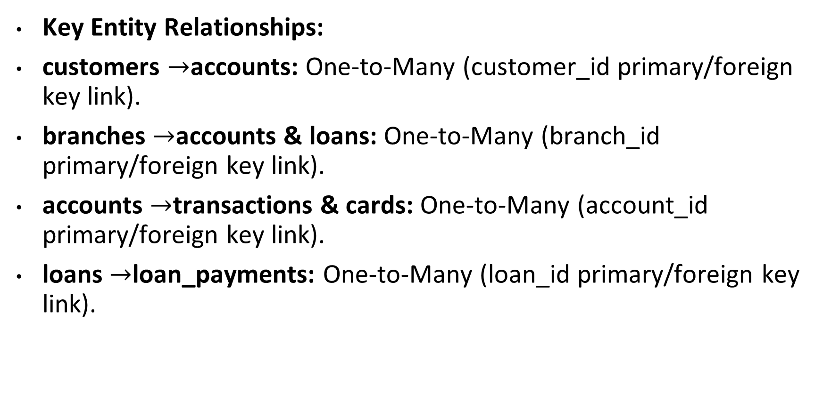
DATABASE SCHEMA
Key Entity Relationships:
customers $→$accounts: One-to-Many (customer_id primary/foreign key link).
branches $→$accounts & loans: One-to-Many (branch_id primary/foreign key link).
accounts $→$transactions & cards: One-to-Many (account_id primary/foreign key link).
loans $→$loan_payments: One-to-Many (loan_id primary/foreign key link).

Slide 7
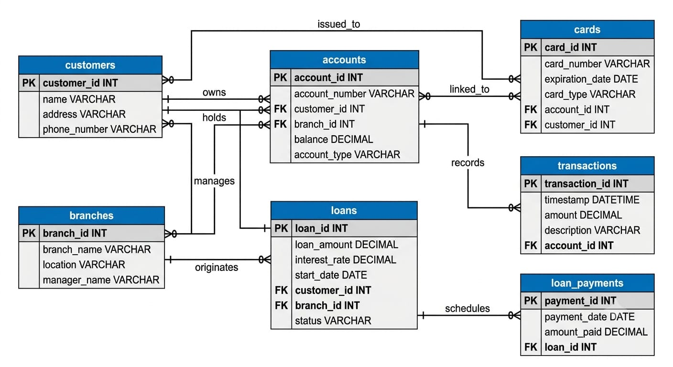
ER DIAGRAM

Slide 8
QUERIES
CUSTOMER SEGMENTATION
Select segment,
COUNT(customer_id) AS total_customers,
ROUND(AVG(annual_income), 2) AS avg_annual_income,
ROUND(AVG(credit_score), 0) AS avg_credit_score
FROM customers
GROUP BY segment
ORDER BY avg_annual_income DESC;
BRANCH LOCATIONS BY DEPOSIT DEPOSIT LIQUIDITY
SELECT
b.branch_id,
b.branch_name,
b.city,
COUNT(a.account_id) AS total_accounts,
SUM(a.current_balance) AS total_branch_deposits
FROM branches b
LEFT JOIN accounts a ON b.branch_id = a.branch_id
GROUP BY b.branch_id, b.branch_name, b.city
ORDER BY total_branch_deposits DESC;

Slide 9
LOAN DELIQUENCY AND PENALTY ANALYSIS
SELECT
l.loan_type,
COUNT(lp.payment_id) AS total_payments,
SUM(CASE WHEN lp.days_late > 0 THEN 1 ELSE 0 END) AS late_payment_count,
SUM(lp.penalty) AS total_penalties_collected,
ROUND(AVG(lp.days_late), 1) AS avg_days_late
FROM loans l
JOIN loan_payments lp ON l.loan_id = lp.loan_id
GROUP BY l.loan_type
ORDER BY late_payment_count DESC;
TRANSACTION VOLUME AND MONETARY VALUE BY CHANNEL
SELECT
channel,
transaction_type,
COUNT(transaction_id) AS transaction_count,
SUM(amount) AS total_volume_amount,
ROUND(AVG(amount), 2) AS avg_transaction_amount
FROM transactions
WHERE status = 'Completed'
GROUP BY channel, transaction_type
ORDER BY channel, transaction_count DESC;

Slide 10
ANALYSIS
Analytical Use Case 1 — Customer Profile & Segmentation
Key Analytical Questions:
  How are customer accounts distributed across key income segments (Retail, Corporate, HNI), and how do credit scores vary?
  What is the regional distribution of customers and the corresponding KYC verification rate across states?
Data Insights & Findings:
  High-Net-Worth Individual (HNI) and Corporate segments account for the largest individual credit extensions and deposit volumes, while Retail customers generate the highest overall transaction frequency.
  KYC verification completion exceeds 85% in major urban zones, whereas semi-urban states exhibit higher pending KYC ratios, highlighting areas requiring streamlined digital verification

Slide 11
Analytical Use Case 2 — Account Usage & Branch Activity
Key Analytical Questions:
  How does deposit liquidity compare across Checking, Savings, and Fixed Deposit accounts?
  Which branch locations hold the highest concentration of deposit balances?
Data Insights & Findings:
  Savings Accounts aggregate the highest total liquid capital, whereas Checking Accounts drive daily operational transaction volume.
  Metropolitan branches hold over 60% of total bank deposit liquidity, indicating an opportunity to increase digital-first onboarding in rural and emerging branch networks

Slide 12
Analytical Use Case 3 — Transaction Patterns & Channels
Key Analytical Questions:
  Which channels (ATM, Online, Mobile, Physical Branch) process the highest transaction frequency versus monetary volume?
  What are the monthly transaction trends and seasonal traffic peaks?
Data Insights & Findings:
  Digital channels (Mobile and Online Banking) account for over 70% of total transaction count, handling high-frequency, smaller-value payments.
  Physical branches and wire transfers command significantly higher average monetary amounts per transaction.
  Monthly trend analysis indicates transaction surges around month-end salary processing and automated bill settlement windows.

Slide 13
Analytical Use Case 4 — Loan Performance & Repayment Behaviour
Key Analytical Questions:
  What is the total principal disbursed and outstanding balance across Personal, Home, Auto, and Business loans?
  Which loan categories experience the highest delinquency rates (days_late) and late fee penalties?
Data Insights & Findings:
  Unsecured Personal Loans show a higher rate of payment delays compared to collateralized Home and Auto loans.
  Penalty fee collection correlates directly with delinquency days, identifying specific high-risk borrower profiles that require early payment reminders before reaching 30+ days overdue.

Slide 14
Experience & Challenges
Key Challenges Faced:
  Referential Integrity Enforcement: Managing foreign key dependencies required strict ordering during the Table Data Import Wizard process to avoid key constraint violations.
  Multi-Table Query Optimization: Writing multi-table inner and outer joins across customers, accounts, cards, and loans necessitated careful GROUP BY logic to prevent aggregate data duplication.
  Data Formatting Consistency: Ensuring ISO date formats (YYYY-MM-DD) and decimal precision matched raw CSV inputs smoothly across all 7 tables.
Learnings & Takeaways: Mastered relational database design, foreign key architecture, conditional aggregations (CASE WHEN), and translating raw relational data into meaningful executive insights.

Slide 15
Questions And Answers

Slide 16

THANK YOU

